Slide 1
Daytum +2 Course Multivariate Analysis
Lecture outline . . .
Multivariate Analysis
Joints and Conditionals
Feature Selection
Multivariate Estimation
Michael Pyrcz, The University of Texas at Austin

Slide 2
Daytum +2 Course Multivariate Analysis
Lecture outline . . .
Multivariate Analysis
Michael Pyrcz, The University of Texas at Austin

Slide 3
Motivation for Multivariate Methods
We typically need to build reservoir models of more than one property of interest.
Expanded by whole earh modeling, closing loops with forward models
Expanded by unconventionals
Subsurface properties may include:
Rock Classification: lithology, architectural elements, facies, depofacies
Petrophyscial: porosity, directional permeability, saturuations
Geophysical: density, p-wave and s-wave velocity
Gemechanical: compressibility / Poisson’s ratio, Yong’s modulus, brittleness, stress field
Paleo- / Time Control: fossil adundances, stratigraphic surfaces, ichnofacies, paleo-flow indicators

Slide 4
Curse of Dimensionality
Working with more features / variables is harder!
More difficult to visualize
More data are required to infer the joint probabilities
Less coverage
More difficult to interrogate / check the model
More likely redundant
More complicated, more likely overfit

Slide 5
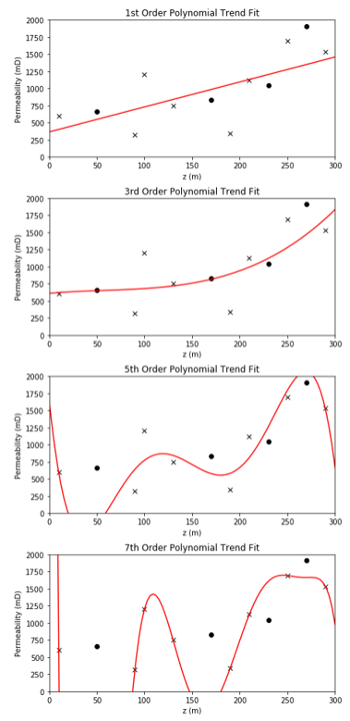
Visualization
Consider this simple model:
1 predictor feature
1 response feature
How’s our model performing?
Accuracy in training and testing
Range of Applicability?
Are we extrapolating?
Overfit
Is the model defendable given the data?

Slide 6
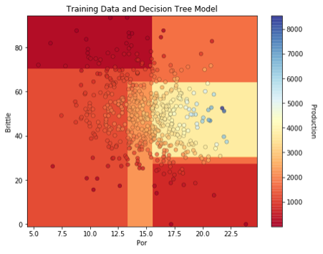
Visualization
Consider this simple model:
2 predictor features
1 response feature
How’s our model performing?
Accuracy in training and testing
Range of Applicability?
Are we extrapolating?
Overfit
Is the model defendable given the data?

Slide 7
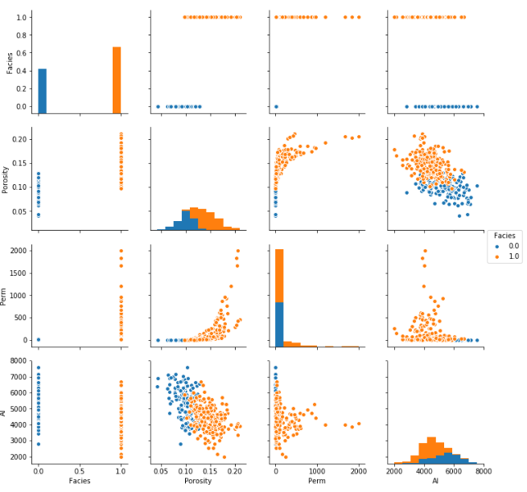
Visualization
Consider this:
4 predictor features
1 response feature (not shown)
What are the relationships between features?
Are there constraints?

Slide 8
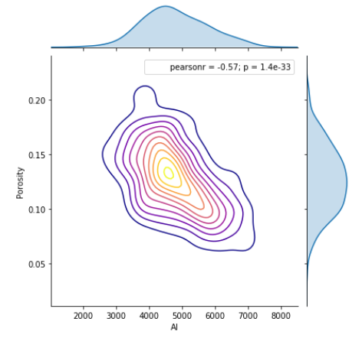
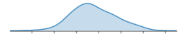
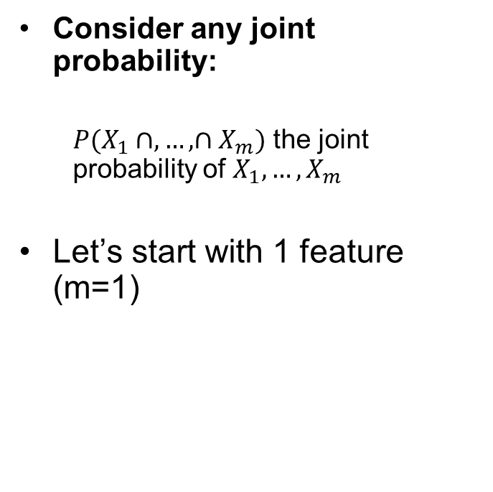
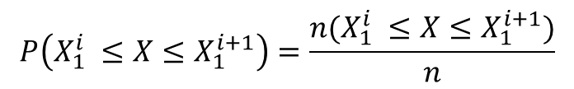
Inferring Joint Probabilities
Consider any joint probability:
$P(X_{1}∩,…,∩X_{m})$ the joint probability of $X_{1},…,X_{m}$
Let’s start with 1 feature (m=1)
$$P\left(X_{1}^{i} ≤X≤X_{1}^{i+1}\right)=\frac{n(X_{1}^{i} ≤X≤X_{1}^{i+1})}{n}$$
In each bin we are estimating a probability!
10 data in each bin = 80 data?

Slide 9
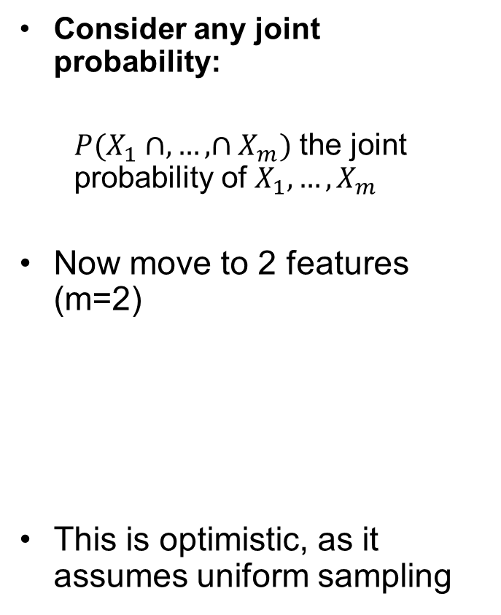
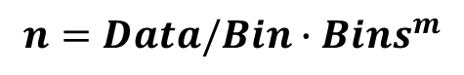
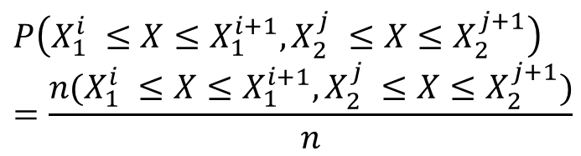
Inferring Joint Probabilities
Consider any joint probability:
$P(X_{1}∩,…,∩X_{m})$ the joint probability of $X_{1},…,X_{m}$
Now move to 2 features (m=2)
This is optimistic, as it assumes uniform sampling
$$P\left(X_{1}^{i} ≤X≤X_{1}^{i+1},X_{2}^{j} ≤X≤X_{2}^{j+1}\right)=\frac{n(X_{1}^{i} ≤X≤X_{1}^{i+1},X_{2}^{j} ≤X≤X_{2}^{j+1})}{n}$$
$$n=Data/Bin∙{Bins}^{m}$$
In each bin we are estimating a probability!
10 data in each bin = 640 data?

Slide 10
Coverage
Consider coverage:
The range of the sample values
The fraction of the possible solution space that is sampled.
Let’s return to 1 feature, and assume 80% coverage!
That’s pretty good right?

Slide 11
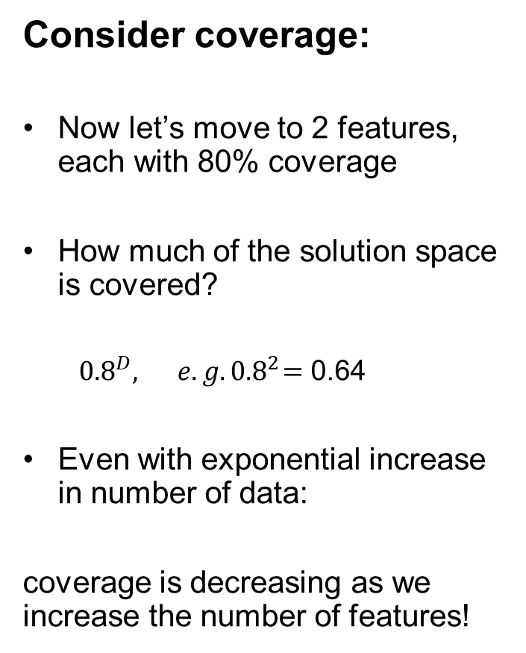
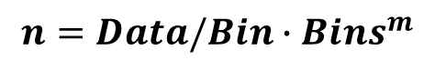
Coverage
Consider coverage:
Now let’s move to 2 features, each with 80% coverage
How much of the solution space is covered?
${0.8}^{D},{ e.g. 0.8}^{2}=$ 0.64
Even with exponential increase in number of data:
coverage is decreasing as we increase the number of features!
$$n=Data/Bin∙{Bins}^{m}$$

Slide 12
Multicollinearity Feature Redundancy
“the existence of such a high degree of correlation between supposedly independent variables being used to estimate a dependent variable that the contribution of each independent variable to variation in the dependent variable cannot be determined”
- Merriam-Webster Online Dictionary
“In statistics, multicollinearity (also collinearity) is a phenomenon in which one predictor variable in a multiple regression model can be linearly predicted from the others with a substantial degree of accuracy.”
- Wikipedia
It is like fitting a plane to a line!

Slide 13
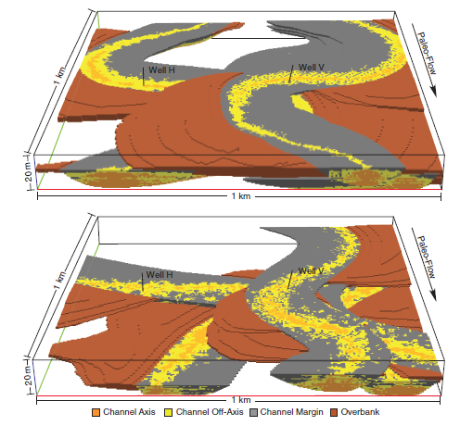
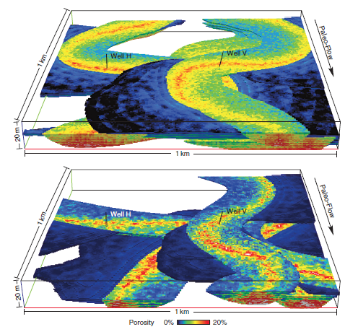
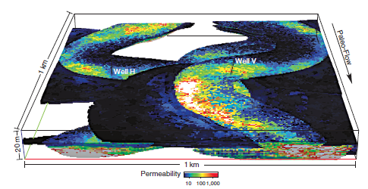
Motivation for Multivariate Methods
A Confession:
Standard geostatistical workflows are bivariate at most
e.g. simulate permeability conditional to porosity
Multiple Facies
Realizations
Multiple Porosity By-facies
Realizations
Categorical Simulation
Continuous Simulation
Models Facies PDF, Trends and Spatial Continuity
Models Porosity PDF, Trends and Spatial Continuity within each facies
Multiple Permeability By-facies
Realizations Correlated with Porosity
Continuous Cosimulation
Models Permeability PDF, Trends and Spatial Continuity and Porosity Relationship within each facies
Note: only had 1 realization on hand (should be two in figure).

Slide 14
Motivation for Multivariate Methods
Emerging Multivariate Methods Include:
Transforms – remove correlations and then model with independent variables and then back-transform to restore correlation (e.g. step-wise conditional transform).
This is beyond the scope of this course.

Slide 15
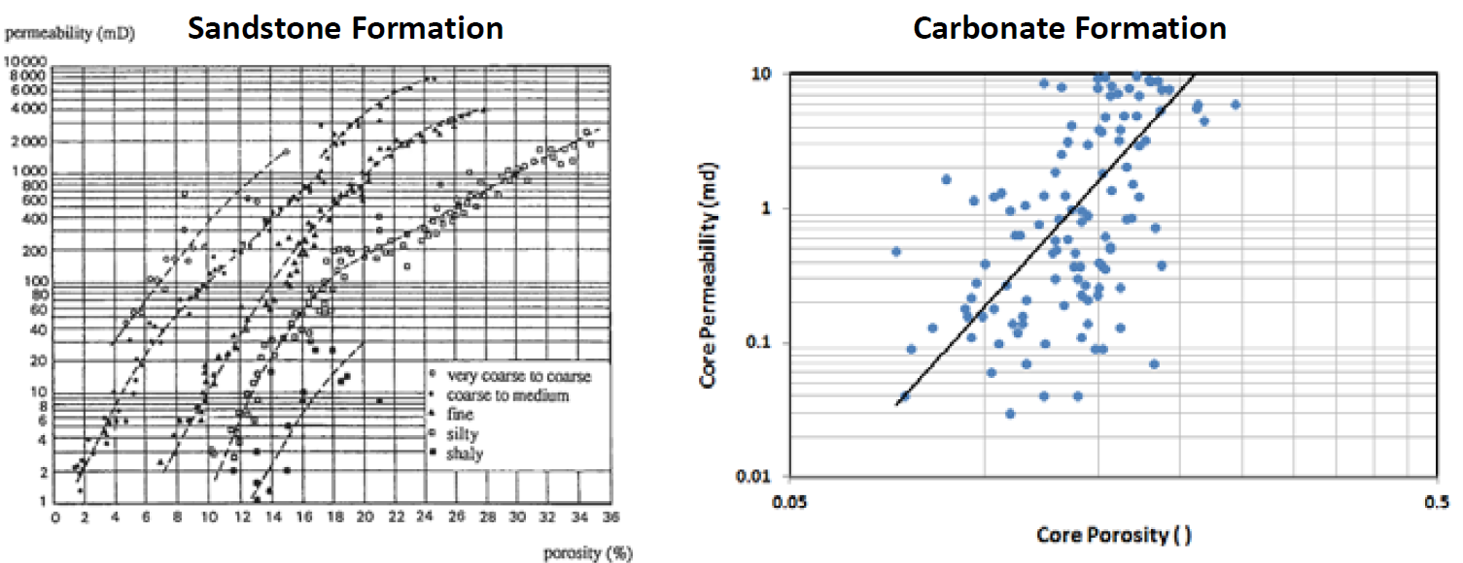
Bivariate Statistics What is Bivariate Analysis?
Bivariate Analysis: Understand and Quantify the relationship between two variables
Example: Relationship between porosity and permeability
How can we use this relationship?
Scatter Plot
Figure from Peters, E. J., 2012, Advanced Petrophysics.
Slide from Dr. Zoya Heidari’s PGE 337 Course

Slide 16
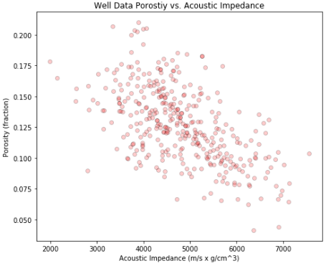
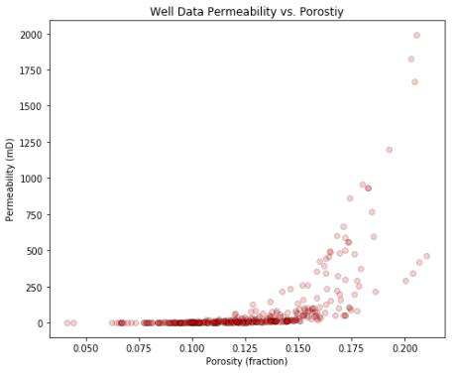
Bivariate Statistics What is Bivariate Analysis?
Examples of bivariate structures
Linear / Nonlinear – shape of the conditional expectation Y | X
Homoscedastic / Heteroscedastic – conditional variance of Y | X
Heteroscedastic
Linear
Non-linear
Homoscedastic

Slide 17
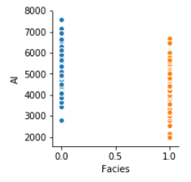
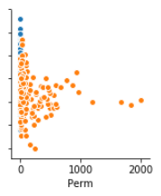
Bivariate Statistics What is Bivariate Analysis?
Examples of bivariate structures
Categorical variables only have a specified number of possible outcomes, continuous takes on a range of possible outcomes.
Constraints – specific combinations of variables are not possible.
Constraints
Continuous
Constraints
Categorical

Slide 18
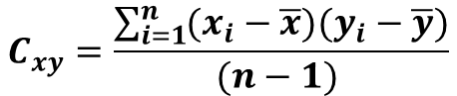
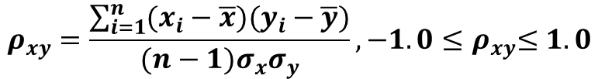
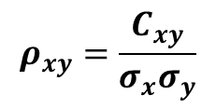
Bivariate Statistics Pearson’s Correlation Coefficient
Definition: Pearson’s Product‐Moment Correlation Coefficient
Provides a measure of the degree of linear relationship.
Correlation coefficient is a standardized covariance.
means of variables
x and y
$$ρ_{xy}=\frac{\sum_{i=1}^{n}{(x_{i}−\overline{x})(y_{i}−\overline{y})}}{(n−1)σ_{x}σ_{y}},{−1.0≤ρ}_{xy}≤1.0$$
Correlation coefficient of
variables x and y
standard deviation of
variables x and y
number of
data pairs
$$C_{xy}=\frac{\sum_{i=1}^{n}{(x_{i}−\overline{x})(y_{i}−\overline{y})}}{(n−1) }$$
$$ρ_{xy}=\frac{C_{xy}}{σ_{x}σ_{y}}$$
Covariance

Slide 19
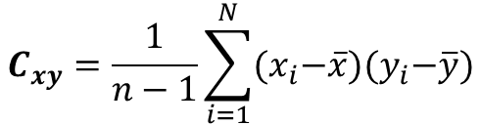
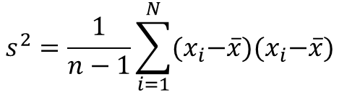
Bivariate Statistics Variance and Covariance
We can see that covariance and variance are related.
Replace the second term in the square with another variable.
Covariance:
A measure of how 2 variables vary together.
Variance:
A measure of how 1 variable varies with itself.
$$C_{xy}=\frac{1}{n−1}\sum_{i=1}^{N}{{(x}_{i}−\overline{x}){(y}_{i}−\overline{y})}$$
$$s^{2}=\frac{1}{n−1}\sum_{i=1}^{N}{{(x}_{i}−\overline{x}){(x}_{i}−\overline{x})}$$

Slide 20
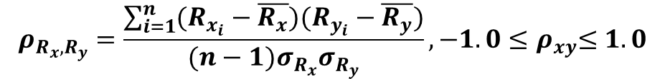
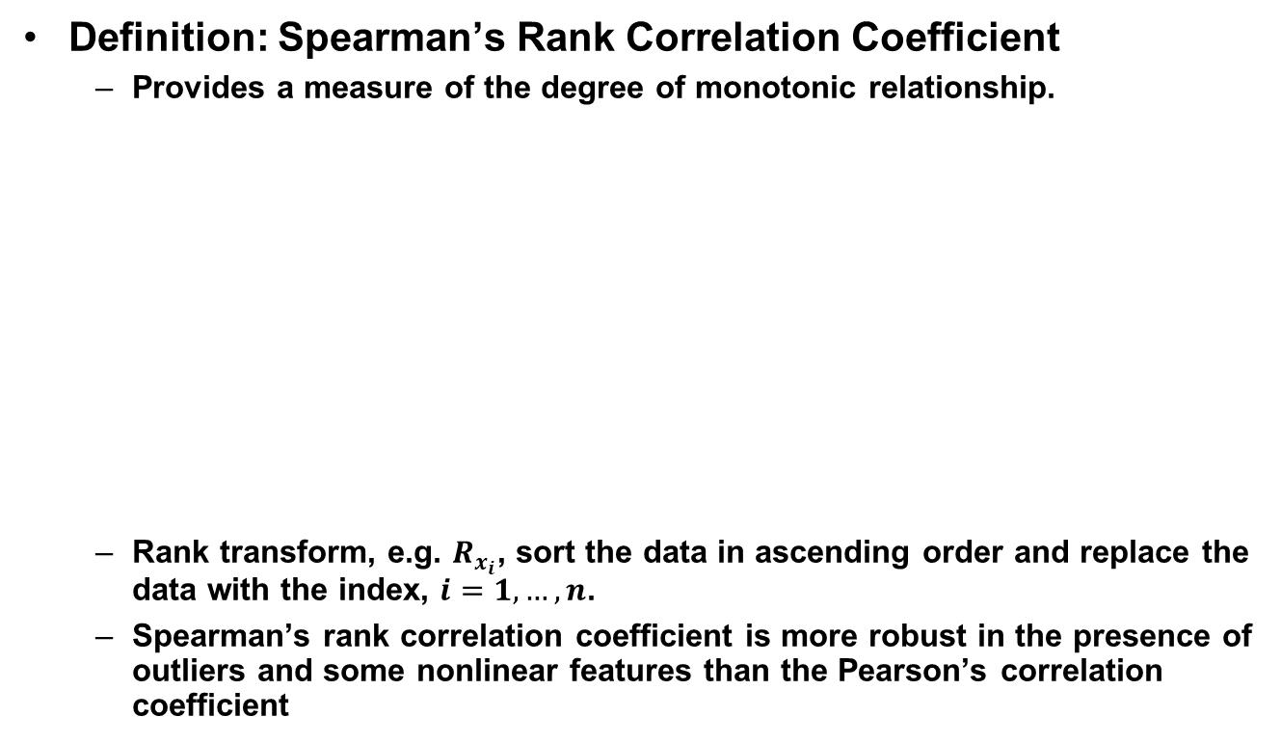
Bivariate Statistics Spearman’s Rank Correlation Coefficient
Definition: Spearman’s Rank Correlation Coefficient
Provides a measure of the degree of monotonic relationship.
Rank transform, e.g. $R_{x_{i}}$, sort the data in ascending order and replace the data with the index, $i=1,…,n$.
Spearman’s rank correlation coefficient is more robust in the presence of outliers and some nonlinear features than the Pearson’s correlation coefficient
means of rank transform of variables
x and y
$$ρ_{R_{x},R_{y}}=\frac{\sum_{i=1}^{n}{(R_{x_{i}}−\overline{R_{x}})(R_{y_{i}}−\overline{R_{y}})}}{(n−1)σ_{R_{x}}σ_{R_{y}}},{−1.0≤ρ}_{xy}≤1.0$$
Rank correlation coefficient of
variables x and y
standard deviation of
Rank transform of variables x and y
number of
data pairs

Slide 21
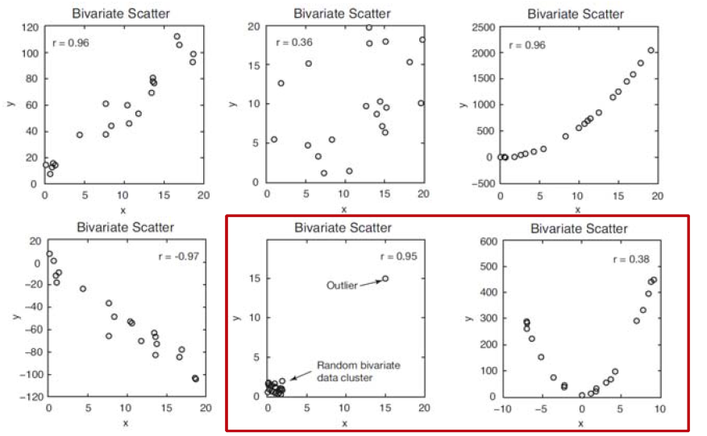
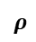
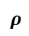
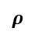
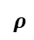
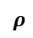
Bivariate Statistics Pearson’s Correlation Coefficient
Interpreting the correlation coefficient
$$ρ$$
$$ρ$$
$$ρ$$
$$ρ$$
$$ρ$$
$$ρ$$
Is Pearson’s correlation coefficient a reliable measure of correlation in these cases?
Slide from Dr. Zoya Heidari’s PGE 337 Course

Slide 22
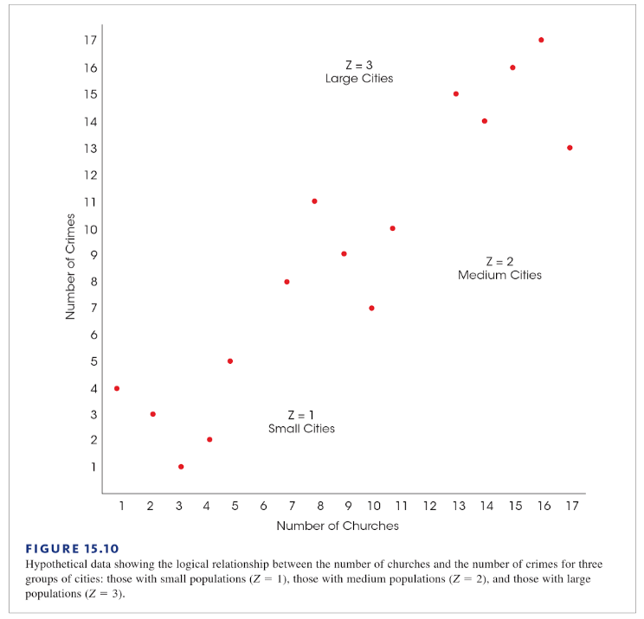
Bivariate Statistics Correlation and Causation
Correlation does not imply causation!
We require a “true experiment” where one variable is manipulated and others are rigorously controlled!

Slide 23
Bivariate Statistics Correlation and Causation
Correlation does not imply causation!
Population was not controlled!
For each size of city the correlation is nearly zero.
Large Cities
Medium Cities
Small Cities

Slide 24
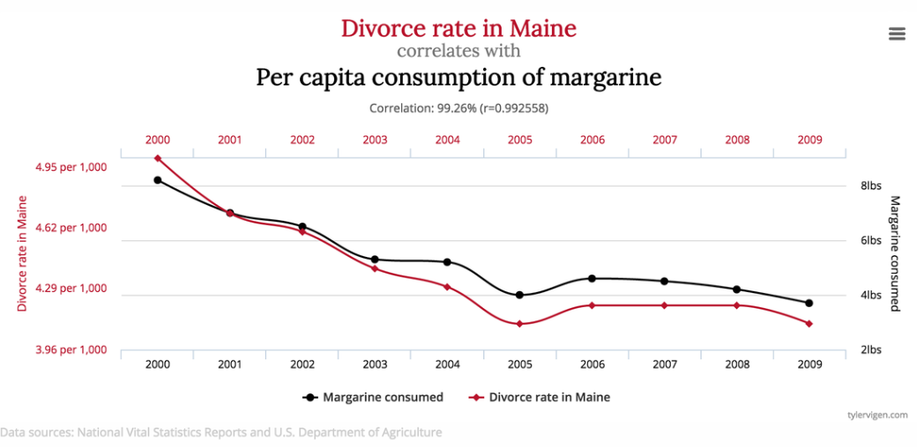
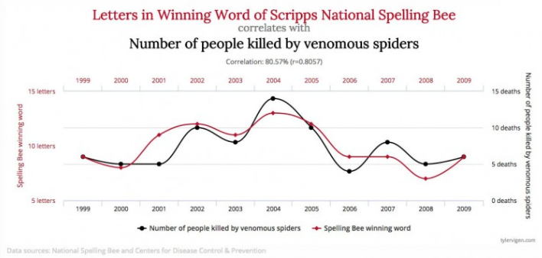
Bivariate Statistics Comical Examples of Correlation and Causation
Margarine causes divorce?
or divorce causes margarine?
Spiders killing people causes longer words in spelling bees?
or longer words in spelling bees causes venomous spiders to kill people?

Slide 25
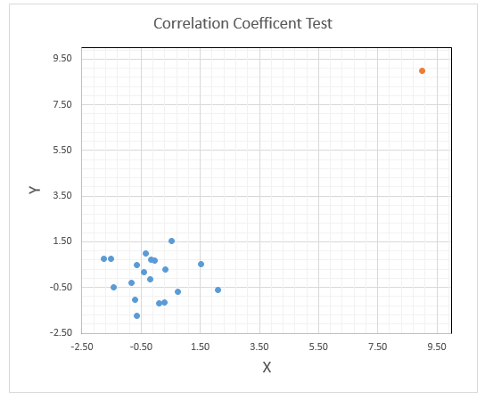
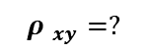
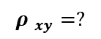
Bivariate Statistics Exercise with Pearson’s Correlation Coefficient
Task 1: Generate a random data set of x and y variables and estimate their correlation coefficient (Hint: Rand() in Excel with N[0,1]).
Task 2: Now add any desired outlier to the data and estimate the correlation coefficient (see example).
How does this outlier affect the correlation coefficient?
$${ρ }_{xy}=?$$
$${ρ }_{xy}=?$$
Excel Function NORM.INV(RAND(),0,1)

Slide 26
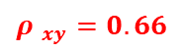
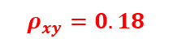
Bivariate Statistics Exercise with Pearson’s Correlation Coefficient
Task 1: Generate a random data set of x and y variables and estimate their correlation coefficient (Hint: Rand() in Excel with N[0,1]).
Task 2: Now add any desired outlier to the data and estimate the correlation coefficient (see example).
How does this outlier affect the correlation coefficient?
With Outlier
$${ρ }_{xy}=0.66$$
Without Outlier
$$ρ_{xy}=0.18$$

Slide 27
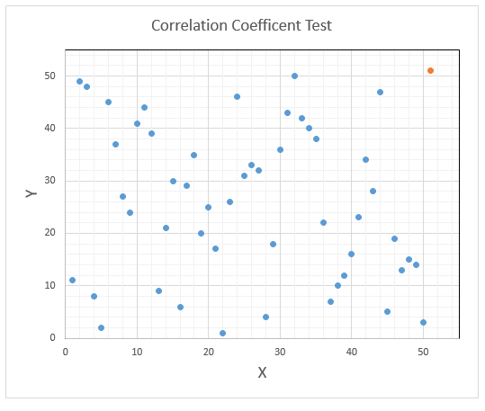
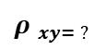
Bivariate Statistics Exercise with Pearson’s Correlation Coefficient
Task 3: Apply the rank transform to the dataset (Hint: 21-Rank.Avg() in Excel).
How does this outlier now affect the correlation coefficient?
This is a more robust form of the correlation coefficient called the rank correlation coefficient.
$${ρ }_{xy= ?}$$
Slide modified from Dr. Zoya Heidari’s PGE 337 Course

Slide 28
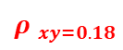
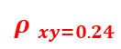
Bivariate Statistics Exercise with Pearson’s Correlation Coefficient
Task 3: Applied the rank transform to the dataset
(Hint: 52-Rank.Avg() in Excel).
How does this outlier now affect the correlation coefficient?
This is a more robust form of the correlation coefficient called the rank correlation coefficient.
With Outlier
$${ρ }_{xy=0.24}$$
Without Outlier
$${ρ }_{xy=0.18}$$
Excel Function =21-RANK.AVG(value,array)
Slide modified from Dr. Zoya Heidari’s PGE 337 Course

Slide 29
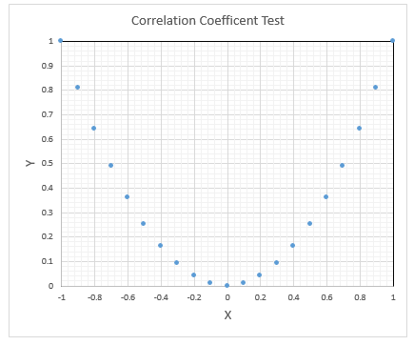
Bivariate Statistics Measuring Linear Relationships with the Correlation Coefficient
Correlation / Covariance is a measure of linear relationship
What is the Correlation / Covariance of y = x^2 over range of [-1, 1]?
Excel Function Correl(array1,array2)

Slide 30
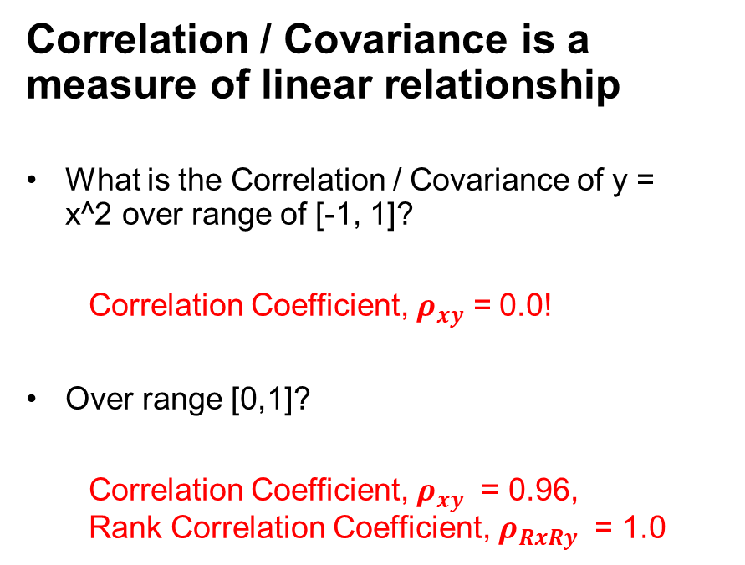
Bivariate Statistics Measuring Linear Relationships with the Correlation Coefficient
Correlation / Covariance is a measure of linear relationship
What is the Correlation / Covariance of y = x^2 over range of [-1, 1]?
Correlation Coefficient, $ρ_{xy}$ = 0.0!
Over range [0,1]?
Correlation Coefficient, $ρ_{xy}$ = 0.96, Rank Correlation Coefficient, $ρ_{RxRy}$ = 1.0
Excel Function Correl(array1,array2)

Slide 31
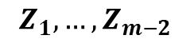
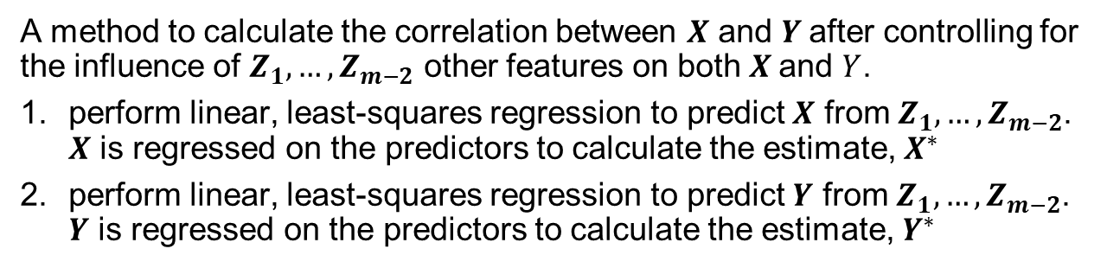
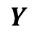


Bivariate Statistics Partial Correlation
A method to calculate the correlation between $X$ and $Y$after controlling for the influence of $Z_{1},…,Z_{m−2}$ other features on both $X$and $Y$.
perform linear, least-squares regression to predict $X$ from $Z_{1},…,Z_{m−2}$. $X$ is regressed on the predictors to calculate the estimate, $X^{∗}$
perform linear, least-squares regression to predict $Y$ from $Z_{1},…,Z_{m−2}$. $Y$ is regressed on the predictors to calculate the estimate, $Y^{∗}$
$$X$$
$$Y$$
$$Z_{1},…,Z_{m−2}$$
$$Z_{1},…,Z_{m−2}$$

Slide 32





Bivariate Statistics Partial Correlation
A method to calculate the correlation between $X$ and $Y$after controlling for the influence of $Z_{1},…,Z_{m−2}$ other features on both $X$and $Y$.
calculate the residuals in Step #1, $X{−X}^{∗}$, where $X^{∗}=f(Z_{1},…,Z_{m−2})$, linear regression model
calculate the residuals in Step #1, ${Y−Y}^{∗}$, where $Y^{∗}=f(Z_{1},…,Z_{m−2})$, linear regression model
$$X{−X}^{∗}$$
$${Y−Y}^{∗}$$
$$Z_{1},…,Z_{m−2}$$
$$Z_{1},…,Z_{m−2}$$

Slide 33



Bivariate Statistics Partial Correlation
A method to calculate the correlation between $X$ and $Y$after controlling for the influence of $Z_{1},…,Z_{m−2}$ other features on both $X$and $Y$.
calculate the correlation coefficient between the residuals from Steps #3 and #4, $ρ_{X{−X}^{∗},Y{−Y}^{∗}}$
The partial correlation, provides a measure of the linear relationship between $X$ and $Y$ while controlling for the effect of $Z_{1},…,Z_{m−2}$ other features on both, $X$ and $Y$.
$${Y−Y}^{∗}$$
$$X{−X}^{∗}$$

Slide 34

Bivariate Statistics Matrix Scatter Plots
For more than two variables make matrix scatterplots
By hand in Excel or packages in R and Python.
Look for linear / nonlinear features
Look for homoscedasticity (constant conditional variance) and heteroscedasticity (conditional variance changes with value)
Look for constraints
heteroscedasticity
constraint

Slide 35
Daytum +2 Course Multivariate Analysis
Lecture outline . . .
Joints and Conditionals
Michael Pyrcz, The University of Texas at Austin

Slide 36












Probability Definitions Conditional, Marginal and Joint Probability
Ω
Probability of B given A occurred? P( B | A)
Conditional Probability
Joint Probability
A
$$P\left(B | A\right)= \frac{P( A ∩ B )}{P\left(A\right)}=\frac{P( A and B )}{P\left(A\right)}$$
$$A∩B$$
B
Marginal Probability
Univariate
Distribution
Marginal
Distribution
Joint
Probability
Bivariate
Distribution
$$F(k)$$
$$k1$$
$$P(φ=φ2,k=k1)$$
Permeability
$$F(k)$$
$$F\left(k \right|φ=φ1)$$
$$F(φ,k)$$
Permeability
Conditional
Distribution
$$φ1$$
$$φ2$$
Porosity
$$F(φ)$$
Porosity
$$F(φ)$$
Univariate
Distribution
Marginal
Distribution

Slide 37


Probability Definitions Conditional, Marginal and Joint Probability
Marginal Probability: Probability of an event, irrespective of any other event
$$P\left(X\right), P(Y)$$
Conditional Probability: Probability of an event, given another event is already true.
$$P(X given Y), P(Y given X)$$
$$P\left(X \right| Y), P(Y|X)$$
Joint Probability: Probability of multiple events occurring together.
$$P(X and Y), P(Y and X)$$
$$P(X ∩ Y), P(Y∩X)$$
$$P(X, Y), P(Y,X)$$
See YouTube Video on Marginals, Conditionals and Joints! https://www.youtube.com/watch?v=bL2gPwMfYpc&index=5&t=0s&list=PLG19vXLQHvSB-D4XKYieEku9GQMQyAzjJ

Slide 38

Marginal, Conditional and Joint Probability
Working directly with marginal, conditional and joint probability
If you have enough data, you can directly calculate all the required probabilities
Go beyond statistics like correlation coefficient
Marginal
Joint
Marginal

Slide 39
Marginal, Conditional and Joint Probability
The Reservoir
Porosity at u₀? What kind of distribution is that?
Marginal Distribution
Continuous Probability Density Function
5%
10%
15%
Marginal Probability, Event A: φ > 10%
5%
10%
15%
Marginal Distribution
Discrete Probability Density Function
Shale
C. Sand
F. Sand
Marginal Probability, Event B: Facies = C. Sand
Shale
C. Sand
F. Sand

Slide 40
Marginal, Conditional and Joint Probability
The Reservoir
Porosity and Permeability at u₀? What kind of distribution is that?
1,000 mD
Joint Distribution
Continuous Joint Probability Density Function
100 mD
10 mD
5%
10%
15%
Univariate, Marginal Examples
Marginal Distribution
Continuous Probability Density Function
1,000 mD
Joint Probability
Event A: 12% < φ < 14% and 600mD < k < 900mD
P(12% < φ < 14% ∩ 600mD < k < 900mD)
100 mD
5%
10%
15%
10 mD
5%
10%
15%
Marginal Probability, Event A: φ > 10%
P(φ > 10%)
1,000 mD
Joint Probability Density Function
Binned
(0% bins removed)
5%
10%
15%
100 mD
Marginal Distribution
Discrete Probability Density Function
10 mD
5%
10%
15%
Shale
C. Sand
F. Sand
Marginal Probability, Event B: Facies = C. Sand
Shale
C. Sand
F. Sand

Slide 41
Marginal, Conditional and Joint Probability
The Reservoir
Permeability Given Porosity = φ₁ at u₀? What kind of distribution is that?
1,000 mD
Conditional Distribution
Continuous Conditional Probability Density Function
100 mD
10 mD
5%
10%
15%
Univariate, Marginal Examples
Marginal Distribution
Continuous Probability Density Function
1,000 mD
Conditional Probability
Event A: 12% < φ < 14% | 600mD < k < 900mD
P(12% < φ < 14% | 600mD < k < 900mD)
100 mD
5%
10%
15%
10 mD
5%
10%
15%
Marginal Probability, Event A: φ > 10%
P(φ > 10%)
Bivariate, Joint Examples
5%
10%
15%
1,000 mD
Joint Distribution
Continuous Joint Probability Density Function
Marginal Distribution
Discrete Probability Density Function
100 mD
10 mD
5%
10%
15%
1,000 mD
Joint Probability
Event A: 12% < φ < 14% and 600mD < k < 900mD
P(12% < φ < 14% ∩ 600mD < k < 900mD)
Shale
C. Sand
F. Sand
100 mD
10 mD
5%
10%
15%
Marginal Probability, Event B: Facies = C. Sand
1,000 mD
Joint Probability Density Function
Binned
(0% bins removed)
100 mD
Shale
C. Sand
F. Sand
10 mD
5%
10%
15%

Slide 42
Marginal, Conditional and Joint Probability
The Reservoir
Bivariate, Conditional Examples
1,000 mD
Conditional Distribution
Continuous Conditional Probability Density Function
100 mD
Univariate, Marginal Examples
10 mD
5%
10%
15%
Marginal Distribution
Continuous Probability Distribution Function
Conditional Probability
Event A: 12% < φ < 14% | 600mD < k < 900mD
P(12% < φ < 14% | 600mD < k < 900mD)
1,000 mD
100 mD
5%
10%
15%
10 mD
5%
10%
15%
Marginal Probability, Event A: φ > 10%
P(φ > 10%)
Bivariate, Joint Examples
1,000 mD
Joint Distribution
Continuous Joint Probability Density Function
5%
10%
15%
100 mD
Marginal Distribution
Discrete Probability Distribution Function
10 mD
5%
10%
15%
1,000 mD
Joint Probability
Event A: 12% < φ < 14% and 600mD < k < 900mD
P(12% < φ < 14% ∩ 600mD < k < 900mD)
Shale
C. Sand
100 mD
F. Sand
10 mD
5%
10%
15%
Marginal Probability, Event B: Facies = C. Sand
Joint Probability Density Function
Binned
(0% bins removed)
1,000 mD
100 mD
Shale
C. Sand
10 mD
5%
10%
15%
F. Sand

Slide 43


Marginal, Conditional and Joint Probability
The Reservoir
How to Calculate a Marginal Distribution from a Joint Distribution?
1,000 mD
Joint Distribution
Continuous Joint Probability Density Function
100 mD
10 mD
5%
10%
15%
Definition of a Marginal Distribution
$$f_{X}\left(x\right)=\int_{−∞}^{+∞}{f_{XY}\left(x,y\right)dy}$$
$$f_{Y}\left(y\right)=\int_{−∞}^{+∞}{f_{XY}\left(x,y\right)dx}$$
or
1,000 mD
1,000 mD
100 mD
100 mD
10 mD
10 mD
5%
10%
15%
5%
10%
15%

Slide 44




Marginal, Conditional and Joint Probability
The Reservoir
Calculate a Conditional Distribution from a Joint Distribution?
1,000 mD
Joint Distribution
Continuous Joint Probability Density Function
100 mD
10 mD
5%
10%
15%
Definition of a Marginal Distribution
$$f_{X}\left(x\right)=\int_{−∞}^{+∞}{f_{XY}\left(x,y\right)dy}$$
$$f_{Y}\left(y\right)=\int_{−∞}^{+∞}{f_{XY}\left(x,y\right)dx}$$
Definition of a Conditional Distribution
or
$$f_{Y|X}\left(y | x\right)=\frac{f_{XY}\left(x,y\right)}{f_{X}\left(x\right)}$$
or
$$f_{X|Y}\left(x | y\right)=\frac{f_{XY}\left(x,y\right)}{f_{Y}\left(y\right)}$$
1,000 mD
1,000 mD
100 mD
100 mD
10 mD
10 mD
5%
10%
15%
1,000 mD
1,000 mD
5%
10%
15%
100 mD
100 mD
10 mD
10 mD
5%
10%
15%
5%
10%
15%

Slide 45



Marginal, Conditional and Joint Probability
The Reservoir
How to Calculate a Joint Distribution?
Definition of a Marginal Distribution
$$f_{X}\left(x\right)=\int_{−∞}^{+∞}{f_{XY}\left(x,y\right)dy}$$
or
$$f_{Y}\left(y\right)=\int_{−∞}^{+∞}{f_{XY}\left(x,y\right)dx}$$
1,000 mD
1,000 mD
100 mD
100 mD
10 mD
10 mD
5%
10%
15%
5%
10%
15%
Definition of a Conditional Distribution
$$f_{Y|X}\left(y | x\right)=\frac{f_{XY}\left(x,y\right)}{f_{X}\left(x\right)}$$
or
$$f_{X|Y}\left(x | y\right)=\frac{f_{XY}\left(x,y\right)}{f_{Y}\left(y\right)}$$
1,000 mD
1,000 mD
100 mD
100 mD
10 mD
10 mD
5%
10%
15%
5%
10%
15%

Slide 46

Marginal, Conditional and Joint Probability
The Reservoir
How to Calculate a Joint Distribution?
Non-parametric - Counting Samples in Bins
1,000 mD
0 | 0 | 0 | 1 | 1
0 | 1 | 2 | 3 | 1
0 | 2 | 2 | 1 | 0
1 | 3 | 2 | 1 | 0
1 | 1 | 1 | 0 | 0
Definition of a Marginal Distribution
$$f_{X}\left(x\right)=\int_{−∞}^{+∞}{f_{XY}\left(x,y\right)dy}$$
or
$$f_{Y}\left(y\right)=\int_{−∞}^{+∞}{f_{XY}\left(x,y\right)dx}$$
100 mD
1,000 mD
1,000 mD
10 mD
100 mD
100 mD
5%
10%
15%
10 mD
10 mD
5%
10%
15%
5%
10%
15%
Fitting a Parametric Model
Definition of a Conditional Distribution
1,000 mD
0 | 0 | 0 | 4% | 4%
0 | 4% | 8% | 12% | 4%
0 | 8% | 8% | 4% | 0
4% | 12% | 8% | 4% | 0
4% | 4% | 4% | 0 | 0
$$f_{Y|X}\left(y | x\right)=\frac{f_{XY}\left(x,y\right)}{f_{X}\left(x\right)}$$
or
$$f_{X|Y}\left(x | y\right)=\frac{f_{XY}\left(x,y\right)}{f_{Y}\left(y\right)}$$
100 mD
1,000 mD
1,000 mD
100 mD
100 mD
10 mD
10 mD
10 mD
5%
10%
15%
5%
10%
15%
5%
10%
15%

Slide 47

Marginal, Conditional and Joint Probability
Consider working with conditional statistics.
Powerful, flexible assessment of multivariate relationships, without linear assumption

Slide 48

Conditional, Marginal and Joint Hands-on
Joint Distribution:
$$f_{XY}\left(x,y\right)$$
Marginal Distribution:
$$f_{X}\left(x\right)=\int_{−∞}^{+∞}{f_{XY}\left(x,y\right)dy}$$
Conditional Distribution:
$$f_{X|Y}\left(x | y\right)=\frac{f_{XY}\left(x,y\right)}{f_{Y}\left(y\right)}$$
Table of Frequencies
1 | 1 | 0 | 0 | 0
2 | 3 | 2 | 0 | 0
1 | 2 | 2 | 1 | 0
0 | 0 | 2 | 3 | 2
0 | 0 | 1 | 1 | 1
Porosity (%)
5% 10% 15% 20% 25%
10% 30% 50% 70% 90%
Fraction Shale (%)

Slide 49
Conditional, Marginal and Joint Hands-on
Joint Distribution:
$$f_{XY}\left(x,y\right)$$
Marginal Distribution:
$$f_{X}\left(x\right)=\int_{−∞}^{+∞}{f_{XY}\left(x,y\right)dy}$$
Conditional Distribution:
$$f_{X|Y}\left(x | y\right)=\frac{f_{XY}\left(x,y\right)}{f_{Y}\left(y\right)}$$
Table of Joint Probabilities
4% | 4% | 0 | 0 | 0
8% | 12% | 8% | 0 | 0
4% | 8% | 8% | 4% | 0
0 | 0 | 8% | 12% | 8%
0 | 0 | 4% | 4% | 4%
Porosity (%)
5% 10% 15% 20% 25%
10% 30% 50% 70% 90%
Fraction Shale (%)

Slide 50

Conditional, Marginal and Joint Hands-on
Given these joint probabilities calculate the:
Marginal Distributions:
$$f_{Vsh}\left(v_{sh}\right)=$$
$$f_{φ}\left(φ\right)=$$
Conditional Distribution:
$$f_{Vsh|φ}\left(v_{sh}| φ=15\%\right)=$$
Table of Joint Probabilities
4% | 4% | 0 | 0 | 0
8% | 12% | 8% | 0 | 0
4% | 8% | 8% | 4% | 0
0 | 0 | 8% | 12% | 8%
0 | 0 | 4% | 4% | 4%
Vsh
10% 30% 50% 70% 90%
Porosity (%)
5% 10% 15% 20% 25%
Porosity
5% 10% 15% 20% 25%
10% 30% 50% 70% 90%
Fraction Shale (%)
Vsh
10% 30% 50% 70% 90%

Slide 51

Conditional, Marginal and Joint Hands-on
Given these joint probabilities calculate the:
Marginal Distributions:
$$f_{Vsh}\left(v_{sh}\right)=$$
$$f_{φ}\left(φ\right)=$$
Conditional Distribution:
$f_{Vsh|φ}\left(v_{sh}| φ=15\%\right)=f_{Vsh,φ}\left(v_{sh},φ=15\%\right)$/$f_{φ}\left(φ=15\%\right)$
Table of Joint Probabilities
4% | 4% | 0 | 0 | 0
8% | 12% | 8% | 0 | 0
4% | 8% | 8% | 4% | 0
0 | 0 | 8% | 12% | 8%
0 | 0 | 4% | 4% | 4%
Vsh
10% 30% 50% 70% 90%
16% | 24% | 28% | 20% | 12%
Porosity (%)
Porosity
5% 10% 15% 20% 25%
5% 10% 15% 20% 25%
12% | 28% | 24% | 28% | 8%
10% 30% 50% 70% 90%
Vsh
10% 30% 50% 70% 90%
Fraction Shale (%)
1/6 | 1/3 | 1/3 | 1/6 | 0

Slide 52

Multivariate Analysis Demo
Demo workflow for Multivariate Analysis file is Daytum_Multivariate.ipynb

Slide 53
Multivariate Topics
Other Topics that Could be Covered
Methods to remove correlation and model variables independently
Methods for dimensional reduction
Methods for clustering analysis

Slide 54
Multivariate New Tools
Topic | Application to Subsurface Modeling
Multivariate Analysis | In the presence of multivariate relationships, must jointly model variables. Summarize with bivariate statistics, and visualize and use conditional statistics to go beyond linear measures.
Limitations of Correlation | Correlation indicates degree of linear correlation and does not imply causation. Visualize and use rank correlation coefficient when needed and apply careful experiments (controlled) to establish causation.
Use Conditional Statistics | Use conditional distributions to communicate the influence of variables on each other. Provides the value of knowing X to predict Y. Assess the influence of acoustic impedance on predicting porosity away from wells with conditional distributions.
Michael Pyrcz, The University of Texas at Austin

Slide 55
Daytum +2 Course Multivariate Analysis
Lecture outline . . .
Feature Selection
Michael Pyrcz, The University of Texas at Austin

Slide 56
Feature Ranking Motivation
Variable Ranking
There are often many predictor features, input variables, available for us to work with for subsurface prediction.
There are good reasons to be selective, throwing in every possible feature is not a good idea!
In general, for the best prediction model, careful selection of the fewest features that provide the most amount of information is the best practice.

Slide 57
Feature Ranking Motivation
More Motivation to Work with Fewer Variables:
more variables result in more complicated workflows that require more professional time and have increased opportunity for blunders
higher dimensional feature sets are more difficult to visualize
more complicated models may be more difficult to interrogate, interpret and QC
inclusion of highly redundant and colinear variables increases model instability and decreases prediction accuracy in testing
more variables generally increase the computational time required to train the model and the model may be less compact and portable
the risk of overfit increases with the more variables, more complexity

Slide 58
What is Feature Ranking?
More Motivation to Work with Fewer Variables:
Feature ranking is a set of metrics that assign relative importance or value to each feature with respect to information contained for inference and importance in predicting a response feature.
There are a wide variety of possible methods to accomplish this.
My recommendation is a wide-array approach with multiple metric, while understanding the assumptions and limitations of each metric.
Here's the general types of metrics that we will consider for feature ranking:
Visual Inspection of Data Distributions and Scatter Plots
Statistical Summaries
Model-based
Recursive Feature Elimination

Slide 59
What is Feature Ranking?
Expert Knowledge:
Also, we should not neglect expert knowledge.
If additional information is known about physical processes, causation, reliability and availability of features this should be integrated into assigning feature ranks.
We should be learning as we perform our analysis, testing new hypotheses.

Slide 60
Feature Ranking Metrics
Metric #1: Visual Inspection
In any multivariate work we should start with the univariate analysis, summary statistics of one variable at a time. The summary statistic ranking method is qualitative, we are asking:
are there data issues?
do we trust the features? do we trust the features all equally?
are there issues that need to be taken care of before we develop any multivariate workflows?

Slide 61

Feature Ranking Metrics
Summary statistics are a critical first step in data checking.
the number of valid (non-null) values for each feature
general behaviors such as central tendency, mean, and dispersion, variance.
issues with negative values, extreme values, and values that are outside the range of plausible values for each property.

Slide 62
Feature Ranking Metrics
Metric #2: Univariate Distributions
As with summary statistics, this ranking method is a qualitative check for issues with the data and to assess our confidence with each feature.
It is better to not include a feature with low confidence of quality as it may be misleading (while adding to model complexity as discussed previously).
Assess our ability to use methods that have distribution assumptions

Slide 63

Feature Ranking Metrics
The univariate distributions look good:
there are no obvious outliers
the permeability is positively skewed as often observed
the corrected TOC has a small zero truncation spike, but it's reasonable
some departure from Gaussian form, could transform

Slide 64
Feature Ranking Metrics
Metric #3: Bivariate
matrix scatter plots are a very efficient method to observe the bivariate relationships between the variables.
this is another opportunity through data visualization to identify data issues, outliers
we can assess if we have collinearity, specifically the simpler form between two features at a time
Bivariate Gaussian is assumed for methods such as correlation and partial correlation

Slide 65

Feature Ranking Metrics
How could we use this plot for variable ranking?
variables that are closely related to each other.
linear vs. non-linear relationships
constraint relationships and heteroscedasticity between variables.

Slide 66
Feature Ranking Metrics
Metric #3: Bivariate
bivariate visualization and analysis is not sufficient to understand all the multivariate relationships in the data
multicollinearity includes strong linear relationships between 2 or more features.
higher order nonlinear features, outliers and coverage?
these may be hard to see with only bivariate plots.

Slide 67

Feature Ranking Metrics
Ranking Method #4 - Pairwise Covariance
Pairwise covariance provides a measure of the strength of the linear relationship between each predictor feature and the response feature.
We now specify our goal of this study is to predict production, our response variable, from the other available predictor features.
We are thinking predictively now, not inferentially, we want to estimate the function, $\hat{f}$ to accomplish this
Covariance:
measures the strength of the linear relationship between features
sensitive to the dispersion / variance of both the predictor and response

Slide 68

Feature Ranking Metrics
Ranking Method #4 - Pairwise Covariance
Sensitive to feature variance
Feature variance is somewhat arbitrary.
For example, what is the variance of porosity in fraction vs. percentage or permeaiblity in Darcy vs. milliDarcy. We can show that if we apply a constant multiplier, cc, to a variable, XX, that the variance will change according to this relationship (the proof is based on expectation formulation of variance):
$$σ_{cX}^{2}=c^{2}σ_{X}^{2}$$
By moving from percentage to fraction we decrease the variance of porosity by a factor of 10,000!
The variance of each variable is potentially arbitrary, with the exception when all the features are in the same units.

Slide 69
Feature Ranking Metrics
Ranking Method #5 - Pairwise Correlation Coefficient
Pairwise correlation coefficient provides a measure of the strength of the linear relationship between each predictor feature and the response feature.
The correlation coefficient:
measures the linear relationship
removes the sensitivity to the dispersion / variance of both the predictor and response features, by normalizing by the product of the standard deviation of each feature

Slide 70
Feature Ranking Metrics
Ranking Method #6 – Rank Correlation Coefficient
The rank correlation coefficient applies the rank transform to the data prior to calculating the correlation coefficient. To calculate the rank transform simply replace the data values with the ranks, where n is the maximum value and 1 is the minimum value.
The rank correlation:
measures the monotonic relationship, relaxes the linear assumption
removes the sensitivity to the dispersion / variance of both the predictor and response, by normalizing by the product of the standard deviation of each.

Slide 71

Feature Ranking Metrics
Ranking Method #7 – Partial Correlation Coefficient
This is a linear correlation coefficient that controls for the effects all the remaining variables
$ρ_{XY.Z}$ and is the partial correlation between $X$ and $Y$after controlling for $Z$.
perform linear, least-squares regression to predict $X$ from $Z_{1,…,m−2}$.
calculate the residuals in Step #1, $X −X^{∗}$
perform linear, least-squares regression to predict $Y$ from $Z_{1,…,m−2}$.
calculate the residuals in Step #1,$Y−Y^{∗}$
calculate the correlation coefficient, $ρ_{XY.Z}=ρ_{X −X^{∗},Y −Y^{∗}}$

Slide 72

Feature Ranking Metrics
Ranking Method #7 – Partial Correlation Coefficient
The partial correlation, provides a measure of the linear relationship between $X$ and $Y$ while controlling for the effect of $Z$ other features on both, $X$and $Y$
To use this method we must assume:
two variables to compare, $X$ and $Y$
other variables to control, $Z_{1,…,m−2}$.
linear relationships between all variables
no significant outliers
approximately bivariate normality between the variables
We are in pretty good shape, but we have some departures from bivariate normality.
We apply a Gaussian transform in the demonstration

Slide 73

Feature Ranking Metrics
Ranking Methods #4 - #7 – Results
Are we converging on porosity, permeability and vitrinite reflectance as the most important variables with respect to linear relationships with the production?
What about brittleness?

Slide 74

Feature Ranking Metrics
Ranking Method # 9 – Model-based Ranking – B coefficients
We could also consider B coefficients from linear regression.
$$Y^{∗ }= \sum_{i=1}^{m}{B_{i}X_{i}+c}$$
These are the linear regression coefficients without standardization of the variables.
Sensitive to feature variance.
We are capturing interactions between variables.

Slide 75

Feature Ranking Metrics
Ranking Method # 9 – Model-based Ranking – $Β$ (beta) coefficients
We could also consider B coefficients from linear regression
$$Y^{s∗ }= \sum_{i=1}^{m}{B_{i}X_{i}^{s}+c}$$
These are the linear regression coefficients with standardization of the variables, $X_{i}^{s}$ and $Y^{s∗ }$(variance = 1)
Not sensitive to variance of the features
We are capturing interactions between variables.

Slide 76

Feature Ranking Metrics
Ranking Methods #4 - #9 – Results
Now what do we see?
Beta demotes permeability!
Porosity, acoustic impedance and vitrinite reflectance retain high metrics

Slide 77

Feature Ranking Metrics
Ranking Methods #11– Recursive Feature Elimination
Recursive Feature Elimination (RFE) method works by recursively removing features and building a model with the remaining features.
model accuracy is applied to identify which attributes (and combination of attributes) contribute the most to predicting the target attribute
any model could be used!
in this example the prediction model based on multilinear regression and indicate that we want to find the best feature based on recursive feature elimination.
the method assigns rank $1,…,m$for all features.

Slide 78
Feature Ranking Metrics
Ranking Methods #11– Recursive Feature Elimination
The recursive feature elimination method with a linear regression model provides these ranks:
1. Total Organic Carbon
2. Vitrinite Reflectance
3. Acoustic Impedance
4. Porosity
5. Permeability
6. Brittleness
A couple of the features moved from our previous assessment, but we are close. The advantages with the recursive elimination method:
the actual model can be used in assessing feature ranks
the ranking is based on accuracy of the estimate

Slide 79
Feature Ranking Metrics
Ranking Methods #11– Recursive Feature Elimination
The recursive feature elimination method with a linear regression model provides these ranks, but this method is sensitive to:
choice of model
training dataset
This method may be applied with cross validation (k fold iteration of training and testing datasets)
optimize variable selection for prediction with testing data after training with training data

Slide 80

Feature Ranking Demonstration in Python
Demonstration of the wide array approach with a documented workflow.
Workflow at file is
Daytum_Feature_Ranking.ipynb

Slide 81
Daytum +2 Course Multivariate Analysis
Lecture outline . . .
Multivariate Estimation
Michael Pyrcz, The University of Texas at Austin

Slide 82




Multivariate Kriging
Simple kriging may be applied to make estimates given a set of collocated secondary variables at the location to estimate the primary variable.
This is not spatial estimation, but multivariate estimation!
Given the assumption of Gaussian distributed variables we have a complete model of uncertainty for the primary variable at location $u$!
We can back transform for uncertainty in the original variable units.
Covariance between secondary variables
Covariance between secondary
and primary variables
$$\left[\begin{matrix}C\left(z_{1},z_{1}\right) & C\left(z_{1},z_{2}\right) & C\left(z_{1},z_{3}\right) \\ C\left(z_{2},z_{1}\right) & C\left(z_{2},z_{2}\right) & C\left(z_{2},z_{3}\right) \\ C\left(z_{3},z_{1}\right) & C\left(z_{3},z_{2}\right) & C\left(z_{3},z_{3}\right)\end{matrix}\right]\left[\begin{matrix}λ_{1} \\ λ_{2} \\ λ_{3}\end{matrix}\right]=\left[\begin{matrix}C\left(z_{o},z_{1}\right) \\ C\left(z_{o},z_{2}\right) \\ C\left(z_{o},z_{3}\right)\end{matrix}\right]$$
$$z_{1}(u),…,z_{3}(u)$$
y
$$z_{0}\left(u\right)?$$
redundancy
closeness
x

Slide 83
Multivariate New Tools
Topic | Application to Subsurface Modeling
Curse of Dimensionality | Reduce problem to lowest dimension possible. Feature ranking determined that porosity may be predicted from acoustic impedance and rock type alone.
Feature Selection | Apply wide array methods to explore the importance of each predictor feature with respect to the response feature. Partial correlation reveals that rock type provides little additional information to acoustic impedance.
Multivariate Kriging | Multivariate kriging combines secondary information sources while accounting for closeness and redundancy. Given secondary data the likelihood distribution for local porosity is mean of 15% and standard deviation of 2.5% with a Gaussian distribution.
Michael Pyrcz, The University of Texas at Austin

Slide 84
Daytum +2 Course Multivariate Analysis
Lecture outline . . .
Multivariate Analysis
Joints and Conditionals
Feature Selection
Multivariate Estimation
Michael Pyrcz, The University of Texas at Austin

